Slide 1

Onondaga County employee open enrollment 2025
Your Voluntary Credit Union Benefit with
The Summit Federal Credit Union

Slide 2


WHO WE ARE
The Summit Federal Credit Union is a member-owned, not-for-profit financial institution serving Western and Central NY for over 80 years
Our financial solutions include a wide range of banking products and services to help you save and borrow at competitive rates and terms
We’re an important part of your company’s employee benefit package and you and your entire family are eligible to join!

Slide 3
WE OFFER FULL-SERVICE BANKING SOLUTIONS
Smart Saving
Traditional Checking
Happy Borrowing
Mortgages
Visa Credit Cards w/ rewards
Convenient Services
Virtual Branch Banking
Direct Deposit w/Early Pay
Home Buyers Dream Program
Auto Loans
Mobile & Online Banking
Quik Tran
Payroll Deduction
Visa Debit Cards w/rewards
Youth Accounts
Online Bill Payment
Digital Wallets
Money Markets and Share Certificates (CDs)
Home Equity Products
Financial Education & Credit Counseling
Personal Loans
Savings & Club Accounts
Health Savings Accounts
Digital Spend Accounts
RoundUp Savings Account
Student Loans

Slide 4
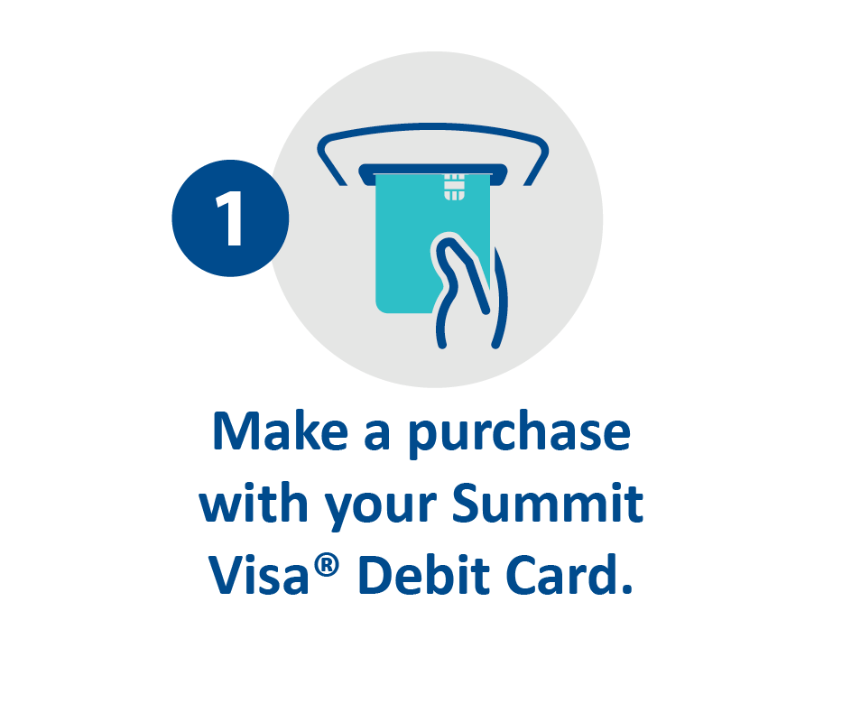
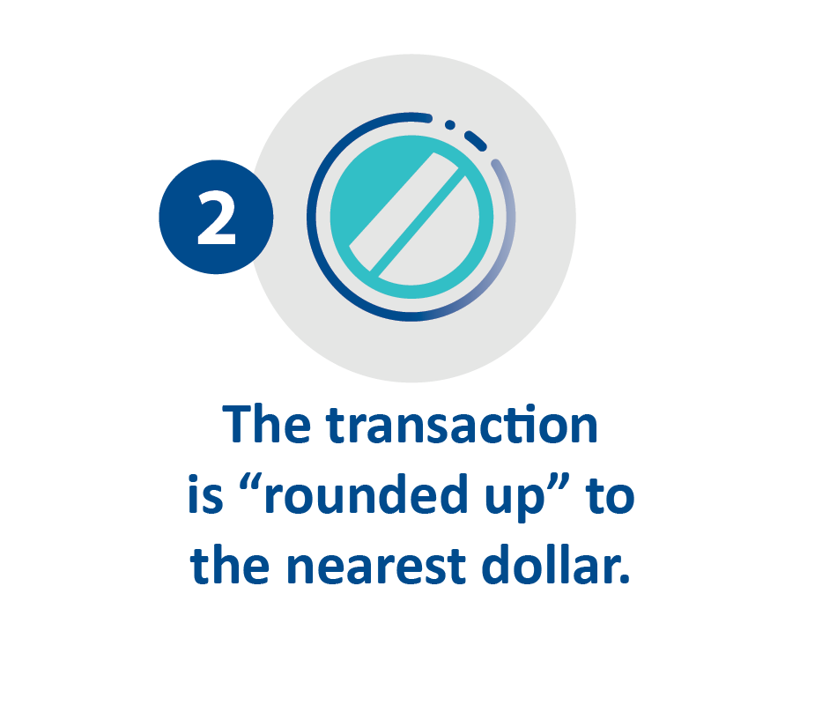
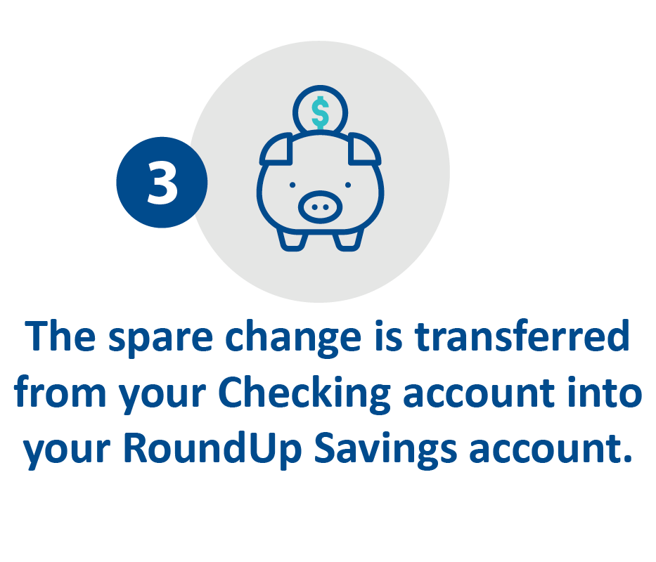
SAVINGS SOLUTIONS
Our RoundUp Savings Account was specifically designed to help you reach your savings goals. How does it work?
As a new or existing Summit member, enrollment is easy.

Slide 5

HOME OWNERSHIP SOLUTIONS
We offer a variety of mortgage products to meet your home buying needs including:
  Fixed Rate Mortgages at 10, 15, 20 & 30-year terms
  Zero Down Mortgages
  3% Down Mortgages
  80/10/10 & 80/15/5 Mortgages
  No Closing Cost Mortgages
  Investment Properties (1-4 family units)

Slide 6

1ST TIME HOMEBUYER SOLUTIONS
The Summit participates in the seasonal* Homebuyer Dream Program through the FHLBNY
This is a seasonal grant program, giving the applicant up to $20,000.00** towards down payment and closing costs for their first home purchase
The Summit waives the PMI (Private Mortgage Insurance) for our members when financing through this program
*This Program is seasonal and available annually in February/March.

Slide 7

STUDENT LOAN OPTIONS
Invest in your future with a student loan from The Summit.
We are proud to offer great low rates on undergraduate and graduate student loans, and student loan refinancing.
Visit www.summitfcu.org/loans/student-loans/
to learn more.

Slide 8
INTRODUCING OUR VIRTUAL BRANCH
We at The Summit are bringing you the personal, face-to-face service you have grown to love — directly to you, wherever you are!
See and talk with a Summit Relationship Specialist by conveniently scheduling a virtual branch appointment. You can do almost everything you’d do at a physical branch — right from your mobile or electronic device.
It’s easy, convenient, safe & secure.
www.summitfcu.org/virtualbranch
Virtual appointments are available
9am – 6pm, Monday thru Friday & 9am – 1pm Saturday

Slide 9
DO YOU HAVE ANY QUESTIONS OR ARE YOU READY TO OPEN AN ACCOUNT TODAY?
Visit a Summit Branch | Schedule your Zoom appointment | Learn more about our solutions
Find a branch near you at summitfcu.org | summitfcu.org/ virtual branch | Visit summitfcu.org
Contact your Summit Business Relations Account Executive today!
Kate Thompson | kcthompson@summitfcu.org |Serving Syracuse, Cortland & Seneca Falls or
Tina Longwell | longwell@summitfcu.org | Serving Rochester & Buffalo

