Slide 1

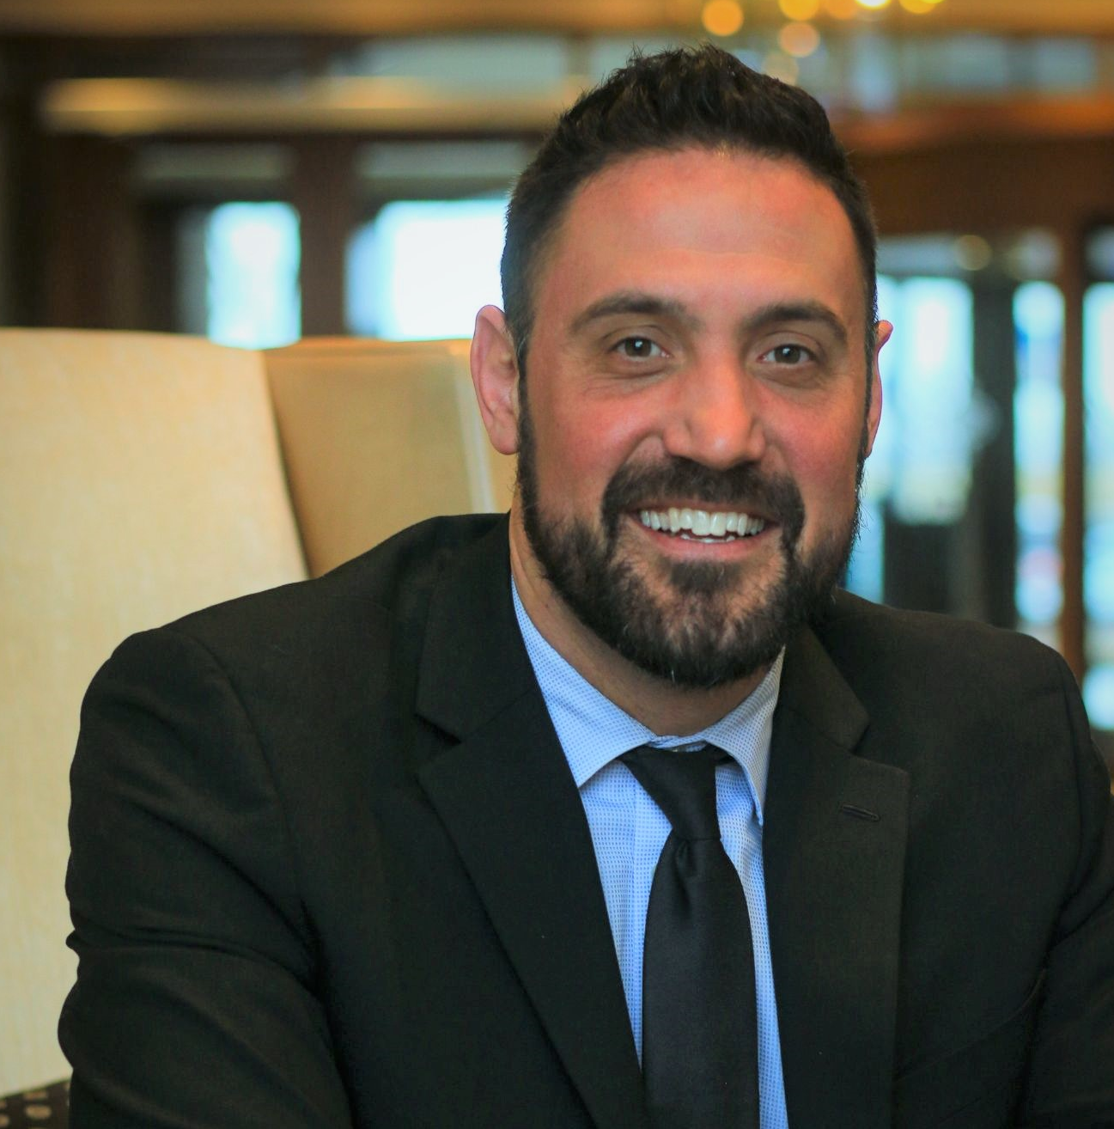
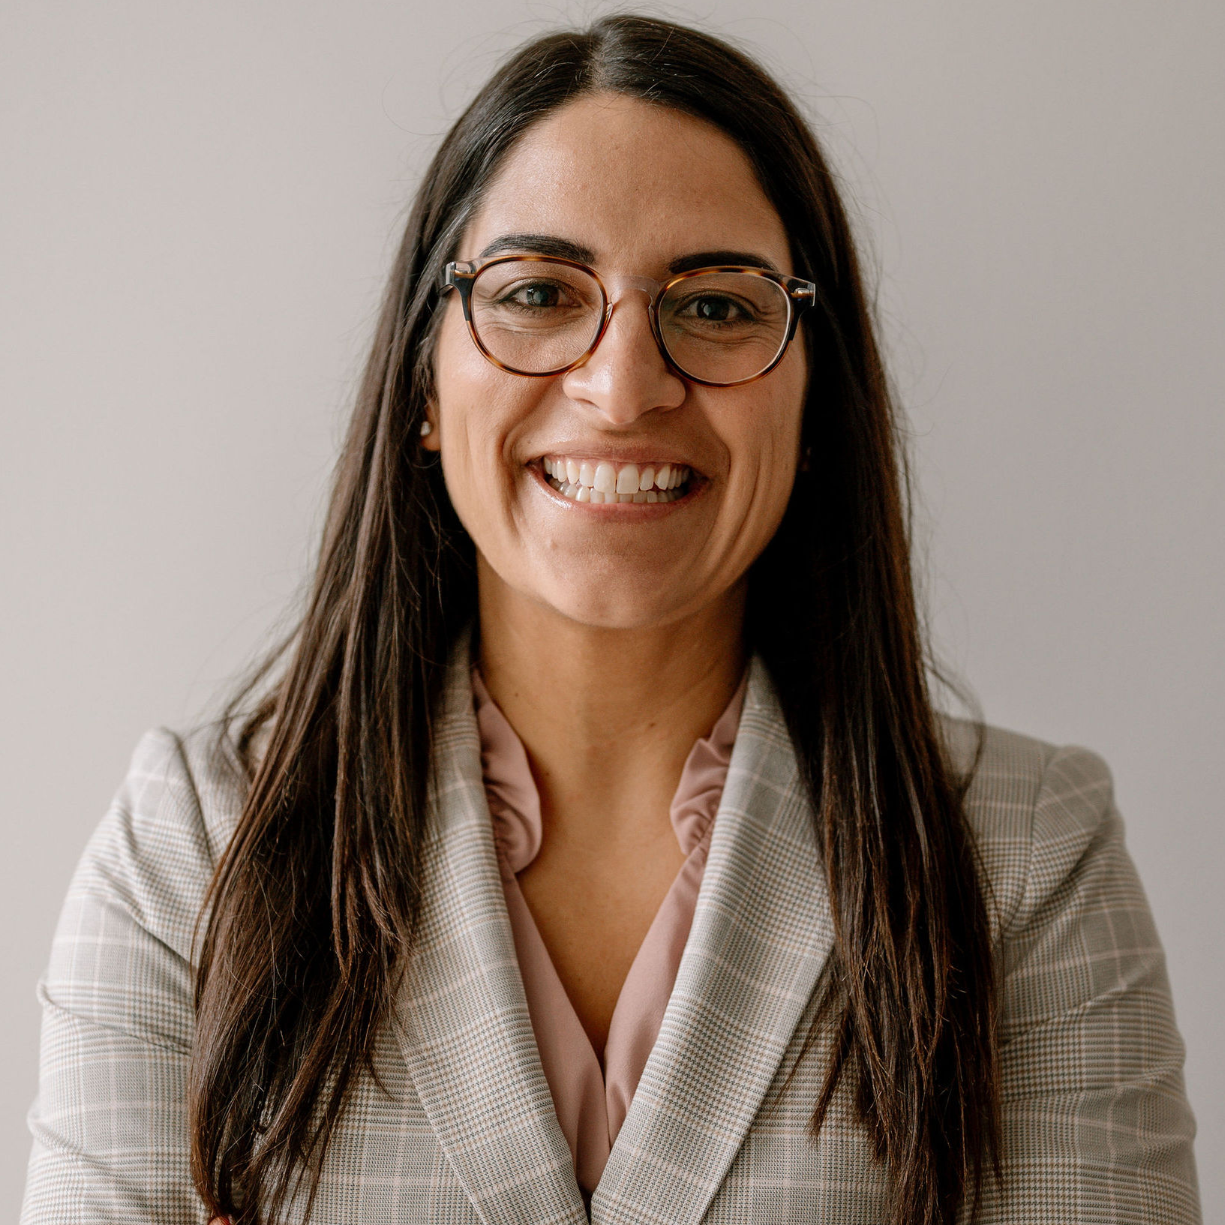
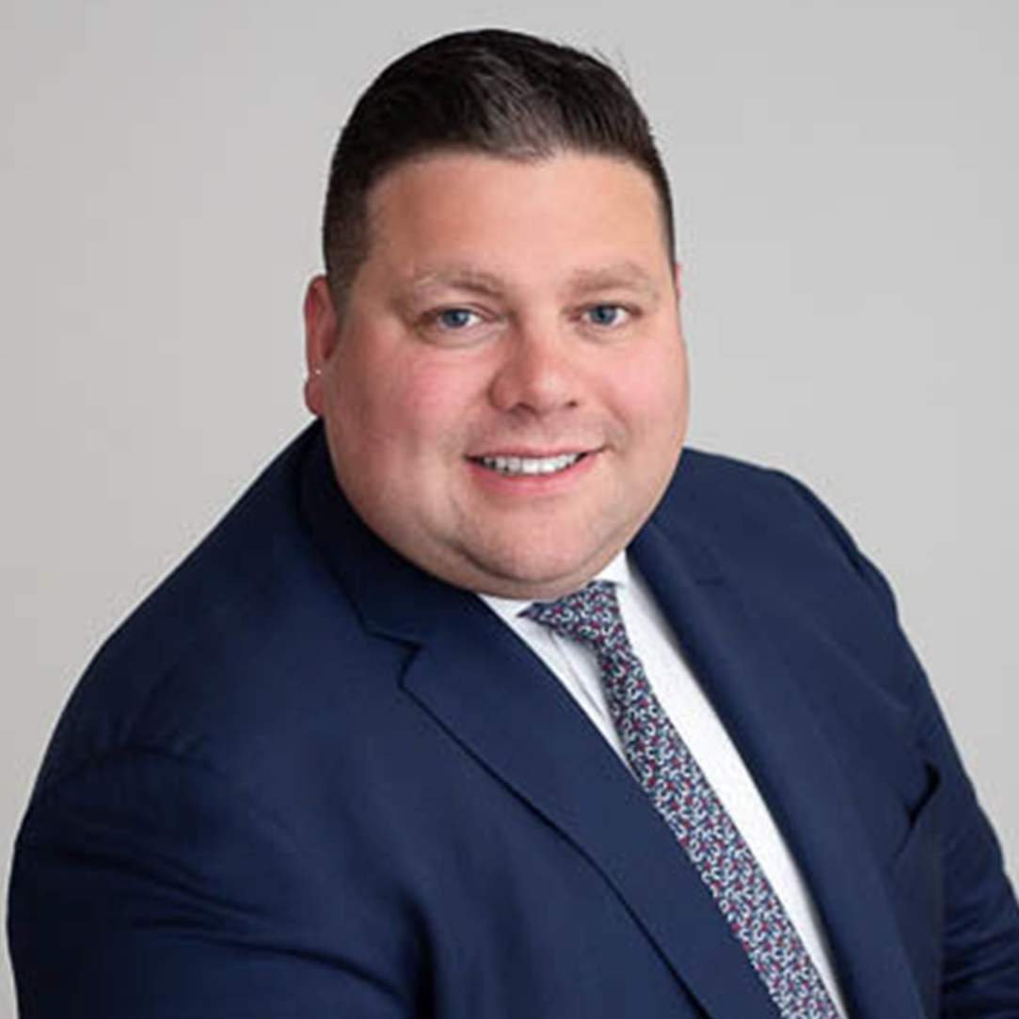
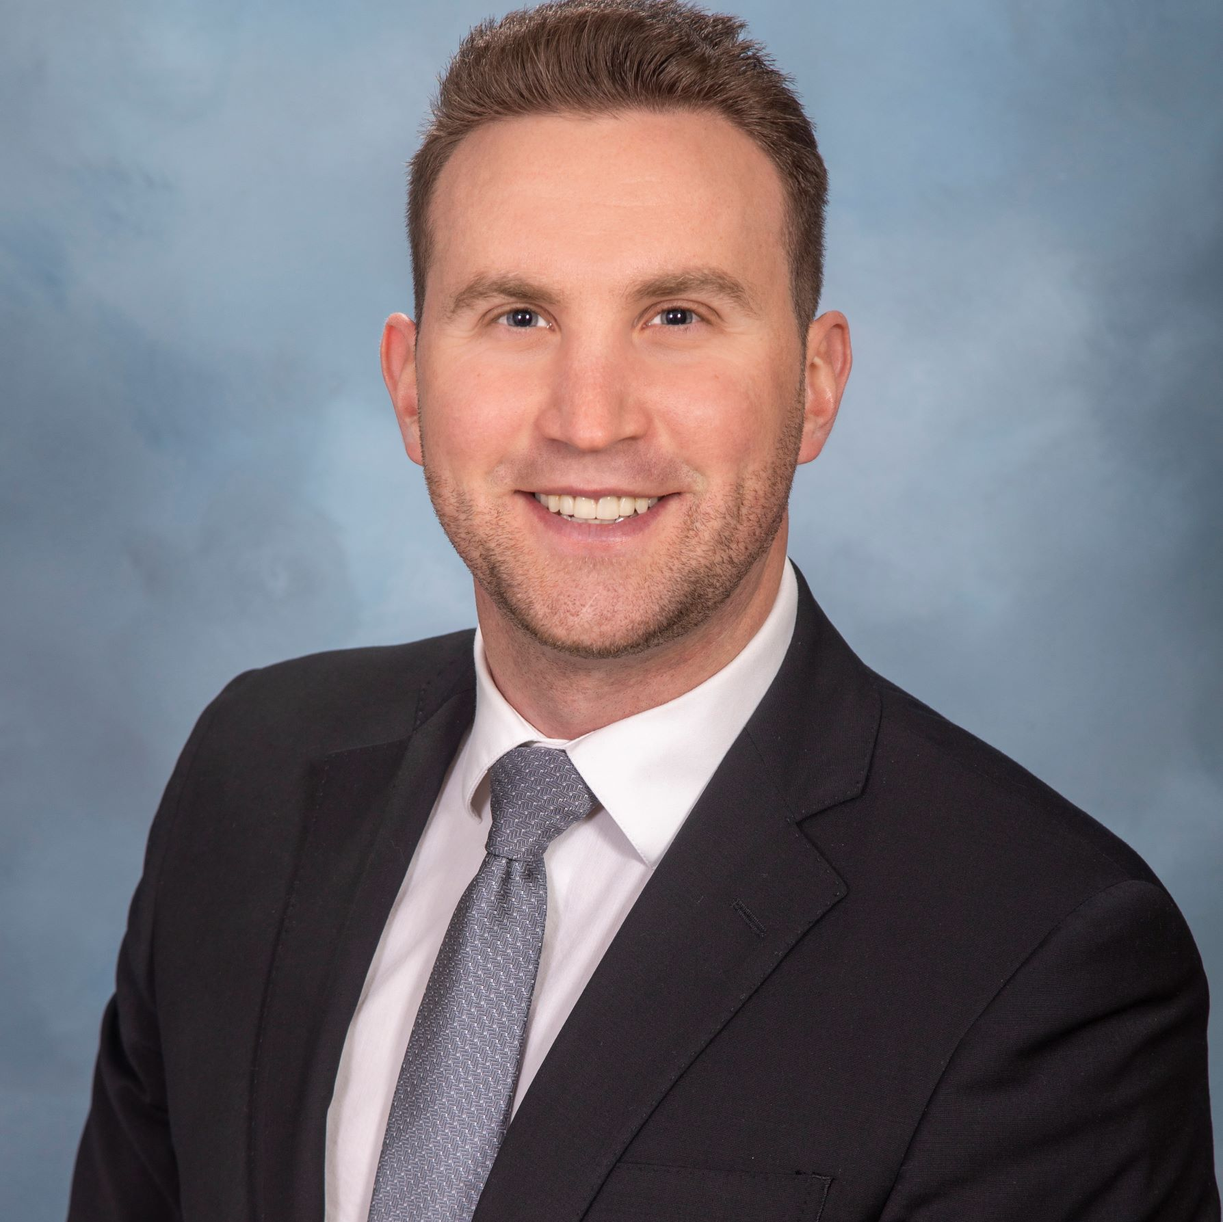
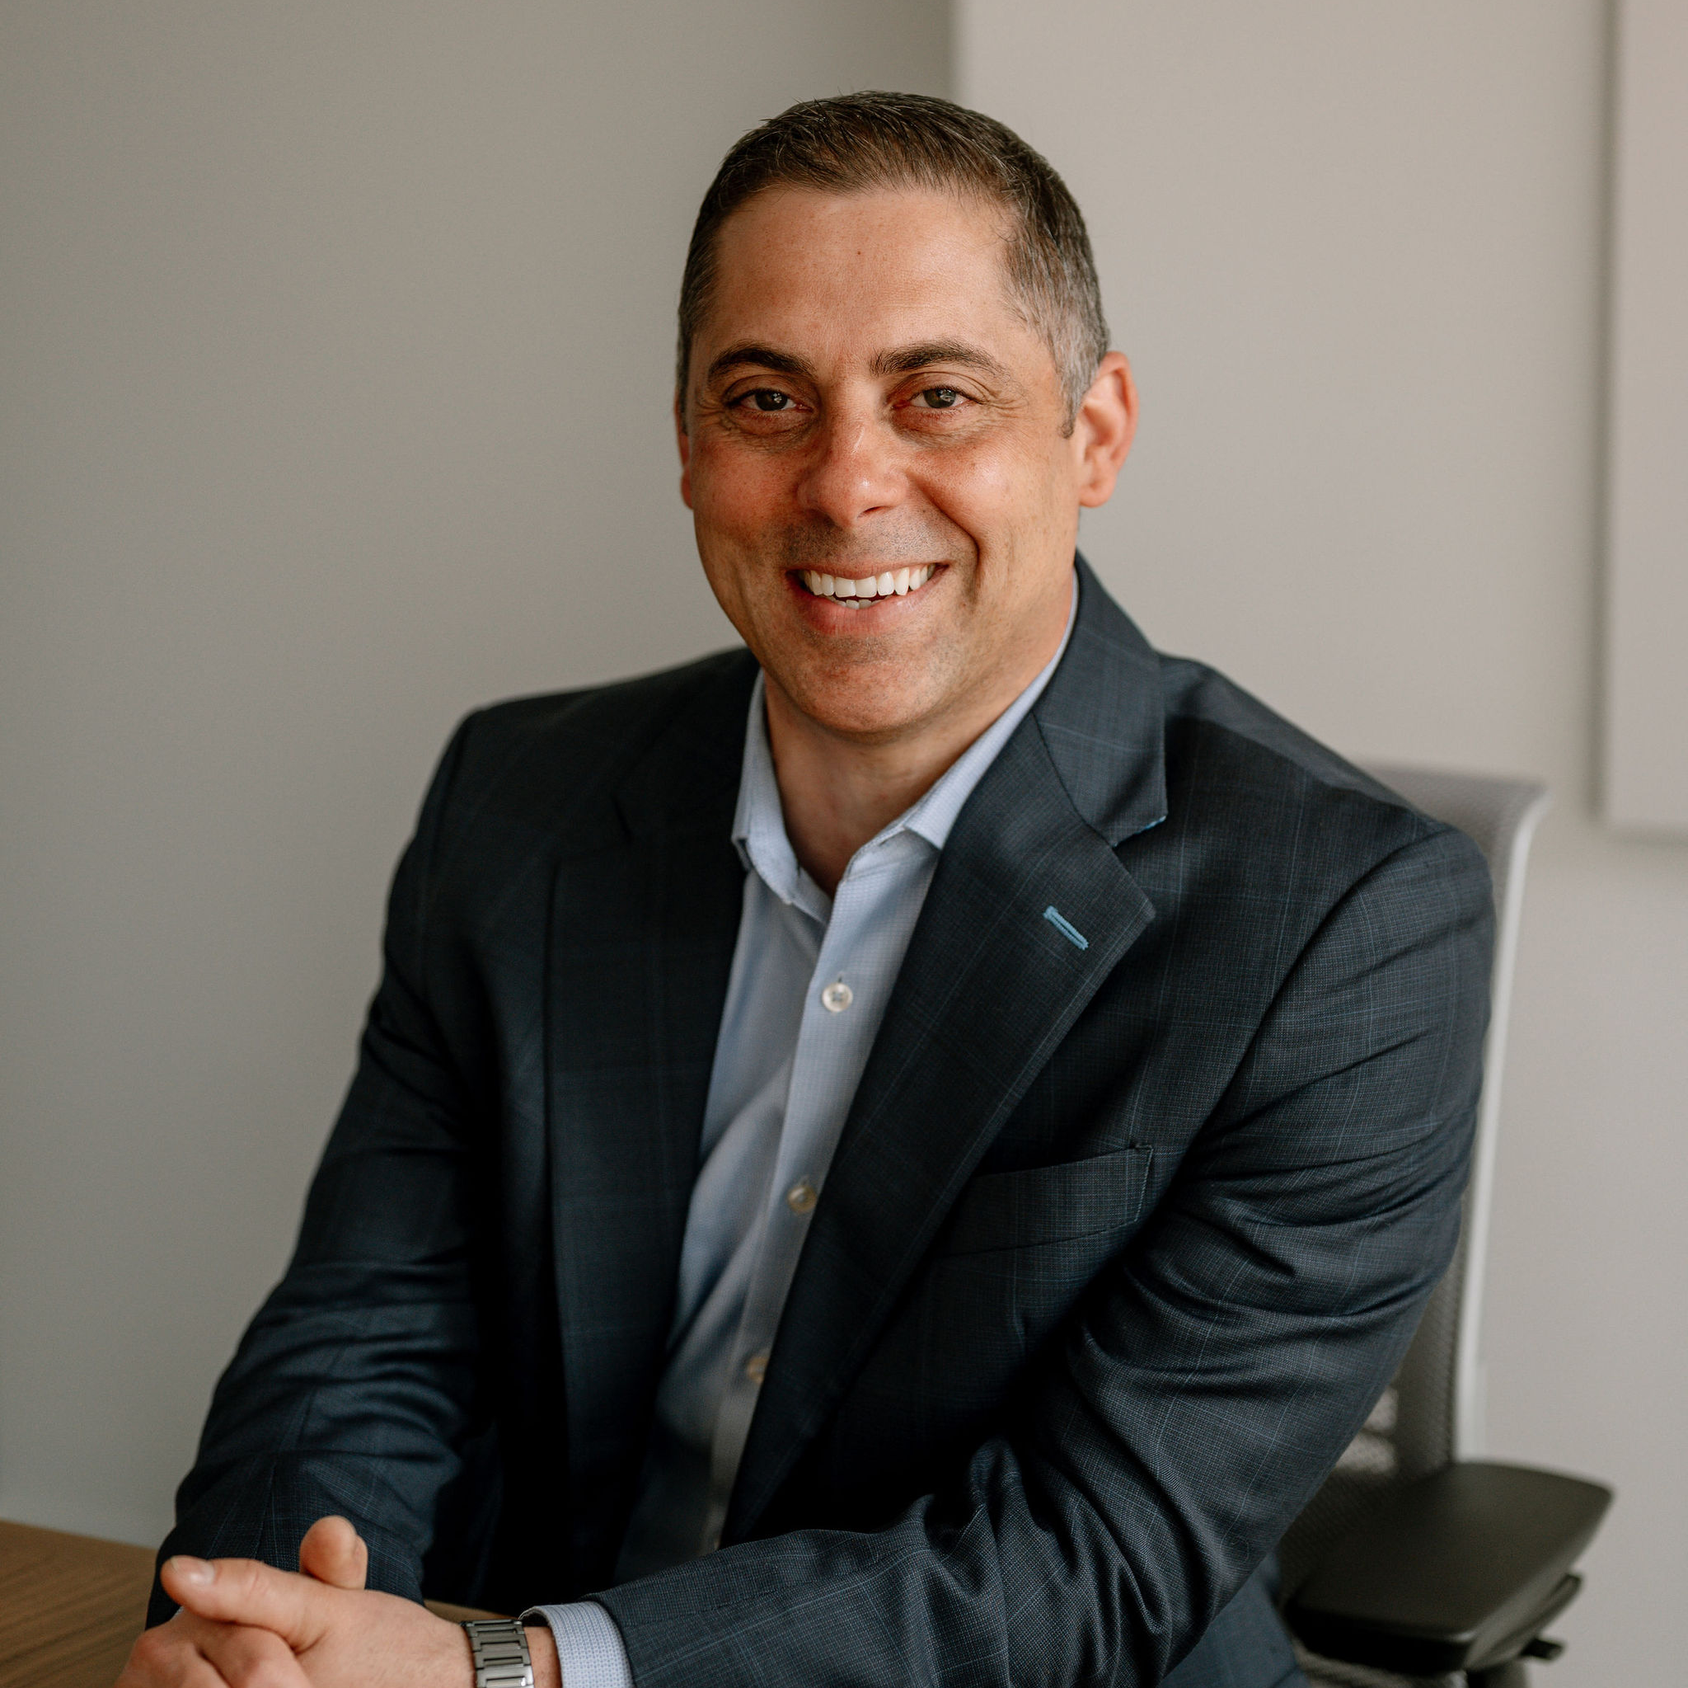
Meet our team
Let us show you how saving a little more now can help you plan for a comfortable retirement tomorrow.
Andrew J. Haberern
Financial Advisor
(315)425-6355
andrew.haberern@equitable.com
Gabrielle L. DiMora
Financial Advisor
(315) 425-6347
gabrielle.dimora@equitable.com
Anthony J. Stevens III
Vice President
(315) 425-6307
anthony.stevens@equitable.com
Michael Fasulo
Financial Advisor
(315)425-6383
michael.fasulo@equitable.com
Deven Coleman
Financial Advisor
(315) 425-6363
deven.coleman@equitable.com
506 Plum Street, Suite 200 | Syracuse, NY 13204 | www.equitable.com/my457
Securities offered through Equitable Advisors, LLC (NY, NY 212-314-4600), member FINRA, SIPC (Equitable Financial Advisors in MI & TN). Investment advisory products and services offered through Equitable Advisors, LLC, an SEC-registered investment advisor. Annuity and insurance products offered through Equitable Network, LLC. PPG-5761642.1 (6/23)(Exp. 6/25).

